Slide 1
A Decision Support System for Diabetes Chronic Care Models Based on General Practitioner Engagement and EHR Data Sharing
Primo Zingaretti, Emanuele Frontoni, Luca Romeo, Michele Bernadini, Sara Moccia
Vani Kamani (B2- 1911085)

Slide 2
Why was this research done?
There is a common lack of clinical strategy
Poor Management of clinical resources
Erroneous implementation of preventive medicine
Diabetes cause 1.5 million deaths, with more than 8 out of 10 deaths occurring in the low and middle income countries
Limited appointment times
Lack of Easy access to Patient Information
Fragmentation of Data between healthcare providers

Slide 3
Some Important Terms
T2D Patients: Patients in whose bodies the hormone of insulin is ineffective.
DSS: Decision Support System
EHR: Electronic Health Record
CDS: Clinical Decision Support
SDM: Share Decision Making
GP: General Practitioner

Slide 4
Overview of the Paper
Clinical data collection of T2D patients from EHRs and data sharing in a cloud infrastructure
Data indicators and features
Enrolled patient management (screening and follow-up): Self-Audit & Data Quality
DSS Analysis on a clinical use case for quality care evaluation
Quality score for economic incentives

Slide 5
Netmedia Italia company has a Cloud computing structure
AUTHORIZATIONS AND AUTHENTICATIONS: Encryption is present when data is transferred and stored
INTEROPERABILITY VIA WEB SERVICES INTERFACE:
API Interface to intercede directly with the cloud computing
It is based on the Simple Object Access Protocol (SOAP) over HyperText Transfer Protocol (HTTP) and the default style is Remote Procedure Call (RPC).
Access, Writing, Consultation, Notifications, Patient Delete and report records- Service Oriented Architecture
DATA EXTRACTOR:
Developed Automatic Extractor software
Normalises the database according to XML format
Timing is scheduled by the GP- data extraction
GUI interface- managing user authorizations, scheduling the process and timing for extraction
DATA COLLECTION

Slide 6
DSS Analysis on a clinical use case for quality care evaluation

Slide 7
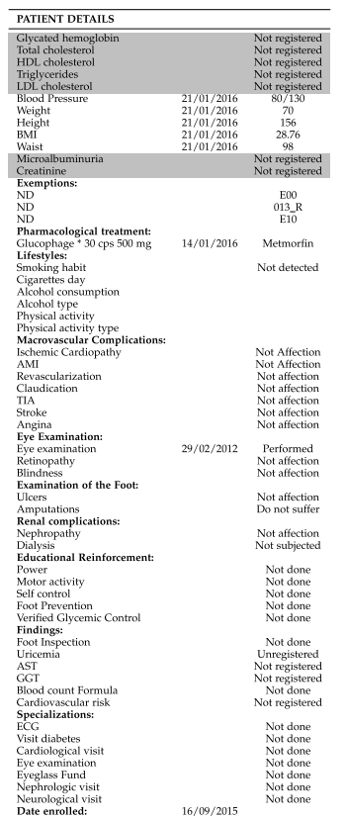
Dataset and Approach
- The dataset comprised of a total of 41237 patients
-Subset of the dataset comprised of 1780 patients was extracted from the entire dataset (41237 patients) and was manually annotated by experts.
-Equal distribution based on the type of the patients
-Team of 10 experts- 5 GPs leading group and 5 Diabetes centres
-5 Likert Scale- 1-5
-Averaging their response according to the vote approach
-Input: Features in the table
- Two years interval (2018-2019) was considered for learning and evaluating the ML model
-The data was used for 6 months to evaluate the improvement of the economic incentives.

Slide 8
Algorithm
Random Forest Algorithm classifying the chronic care quality
RF is a variant of bagging consists of ensemble of decision trees
Changing 2 tree parameters- max n of splits and max n of size
Splitting of the features based on Gini Index
10 cross-validation procedure was implemented, dividing all datasets into 10 folds and selecting iteratively nine folds for training and one fold for testing.
Optimization of features- grid search and optimizing the macro- recall in a nested five-fold cross validation
Azure Machine Learning Studio was used to implement this algorithm in this paper

Slide 9
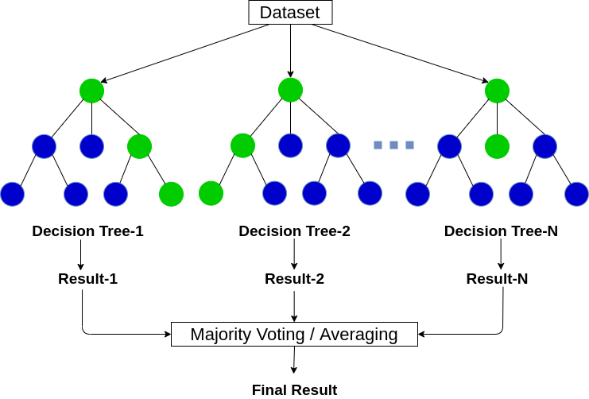
Random Forest Algorithm

Slide 10
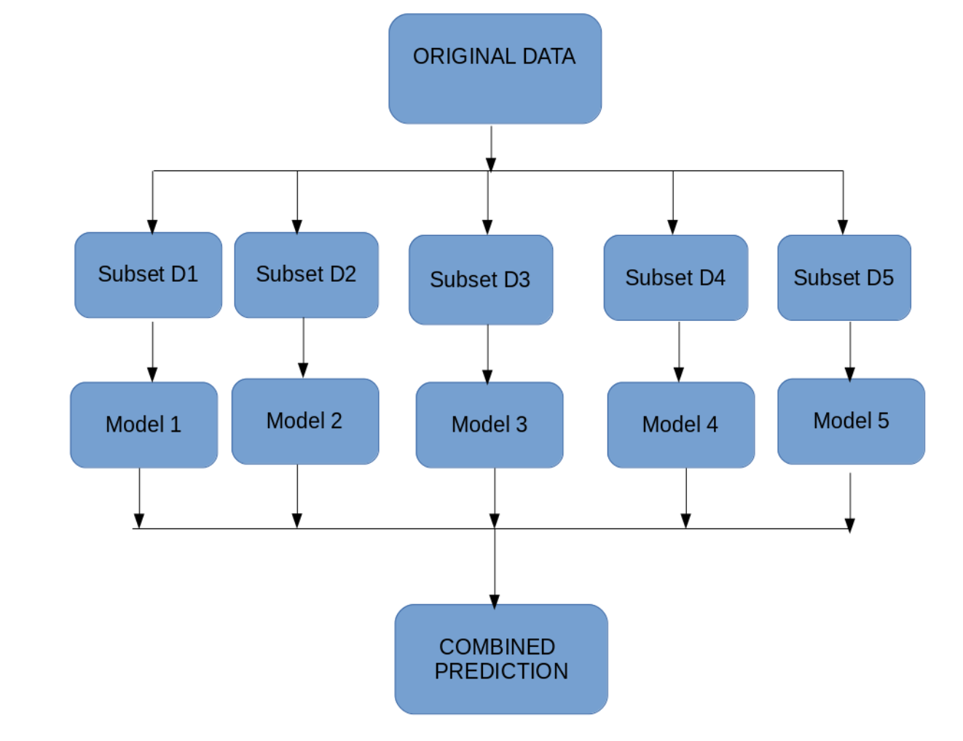
Bagging technique of the Ensemble Learning

Slide 11

Cross Validation and Grid Search

Slide 12
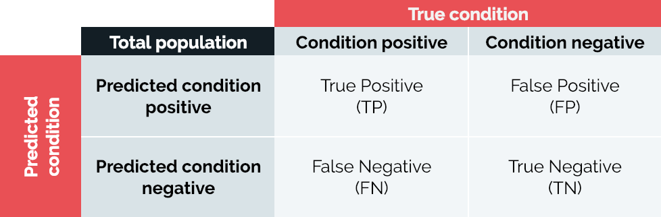
Macro- Recall

Slide 13
Machine Learning Results
Overall accuracy: 98% ± 2% and macro-recall of 96% ± 1%
Close relationship between indicators taken and Chronic care
Providing incentives to the GPs helped in improving the quality of the care of the patients
Brought significant improvement of the category- Patient without any complications with more than 12% increase in the first 6 months

Slide 14
Limitations
Future Work
Might be limited to Diabetic Care
Physician’s preparation and awareness to adapt the recommendations of the guidelines to the specificity of the individual patient
Validate the proposed DSS for the management of different chronic diseases and
Generalize and standardize these quality indicators for the prediction of chronic care quality related to different pathology
Store GP’s feedback temporarily. In this scenario a sequential ML model can be exploited to temporarily model the ground-truth chronic care quality observations.

Slide 15
Conclusion
Real clinical use-case scenario and over time a comprehensive framework for supporting the GPs during the diabetes early detection & enrollment stage.
Integrated chronic care model based on machine learning and data sharing between GPs and diabetes centers, as the main core of a decision support system.
The quality care evaluation in a clinical use-case scenario demonstrated how the empowerment of the GPs through the use of the platform along with the economic incentives, may speed up the improvement of care.
One of the goal of the chronic care models described in this paper is to prove a long-term positive balance on the overall care strategy and budget, both in economic value and in quality of life.

Slide 16
Implementation Strategy
Implementation of the Random Forest Algorithm
Predict Diabetes in the Patients
769 patients’ Dataset

Slide 17
Bibliography
https://www.kaggle.com/uciml/pima-indians-diabetes-database
https://www.geeksforgeeks.org/service-oriented-architecture/
https://www.analyticsvidhya.com/blog/2020/05/decision-tree-vs-random-forest-algorithm/
https://www.analyticsvidhya.com/blog/2020/03/beginners-guide-random-forest-hyperparameter-tuning/?utm_source=blog&utm_medium=decision-tree-vs-random-forest-algorithm
https://www.analyticsvidhya.com/blog/2018/06/comprehensive-guide-for-ensemble-models/?utm_source=blog&utm_medium=decision-tree-vs-random-forest-algorithm

